Slide 1
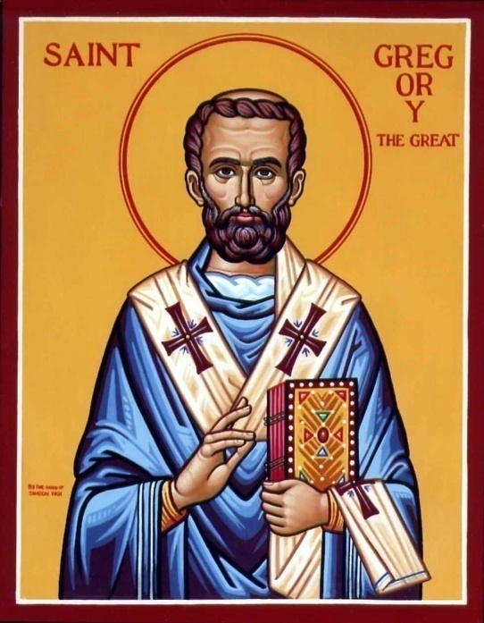
Gregorian Liturgy Replies

Slide 2
¿ Hiten ni`precbia ¿
Pilaoc@
Hiten ni`precbia `nte };e`otokoc e;ouab Maria@ `P[oic `ari`hmot nan `mpi,w `ebol `nte nennobi.
Tenouwst `mmok `w Pi`,rictoc nem Pekiwt `n`aga;oc nem Pi`pneuma E;ouab@ je (ak`i) akcw] `mmon.
`Eleoc `irynyc@ ;ucia `enecewc.

Slide 3
¿ Through the Intercessions ¿
Congregation@
Through the intercessions of the Theotokos, Saint Mary, O Lord, grant us the forgiveness of our sins.
We worship You, O Christ, with Your good Father and the Holy Spirit, for You (have come) and saved us.
A mercy of peace, a sacrifice of praise.

Slide 4
¿ Orthodox Creed ¿
Pilaoc@
Congregation@
Tenjoust `ebol qa `thy `n]`anactacic `nte nirefmwout@ nem piwnq `nte pi`ewn e;nyou. `Amyn. | We look for the resurrection of the dead, and the life of the age to come. Amen.

Slide 5
¿ Anaphora Replies ¿
Pilaoc@
Congregation@
Ke meta tw `pneumatoc cou. | And with your spirit.
E,omen `proc ton Kurion. | We have them with the Lord.
Axion ke dikeon. | It is meet and right.

Slide 6
¿ Je Nai Nan ¿
Pilaoc@
Congregation@
Ele`ycon `ymac `o :eoc `o Cwtyr `ymon. | Have mercy upon us, O God, our Savior.
Ele`ycon `ymac `o :eoc `o Cwtyr `ymon. | Have mercy upon us, O God, our Savior.
Ele`ycon `ymac `o :eoc `o Cwtyr `ymon. Kurie `ele`ycon. | Have mercy upon us, O God, our Savior. Lord have mercy.

Slide 7
¿ Ere Pou`cmou ¿
Pilaoc@
Congregation@
Ere pou`cmou e;ouab swpi neman@ `amyn. Doxa ci Kurie@ Kurie `ele`ycon Kurie `ele`ycon@ Kerie `eulogycon@ Kurie `anapaucon@ `amyn. | May their holy blessings be with us. Amen. Glory to You, O Lord. Lord have mercy; Lord have mercy. Lord, bless us; Lord, repose them. Amen.

Slide 8
¿ Bwl `Ebol
Bwl `ebol ,w `ebol@ `aricun,wrin nan `Vnou] `nnenparaptwma@
Ny`etanaitou qen penouws nem ny`etanaitou qen penouws an.
Ny`etanaitou qen ou`emi@ nem ny`etanaitou qen oumetat``emi.
Nyethyp nem nye;ouwnh `ebol@ `P[oic ek`e,au nan `ebol.

Slide 9
Bwl `Ebol in English
Loose, remit, and forgive us, O God, our iniquities which we have committed willingly and which we have committed unwillingly, which we have committed knowingly and which we have committed unknowingly; the hidden and the manifest, O Lord, remit for us.

Slide 10
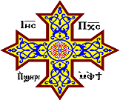
Oujai qen `P[oic

