Slide 1
Coptic Lesson 10
Coptic Numbers

Slide 2
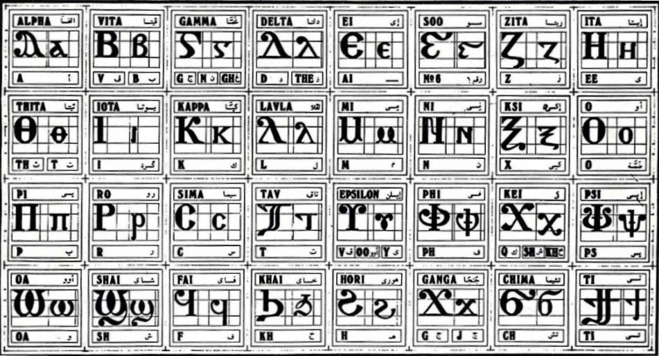
Coptic Alphabets

Slide 3
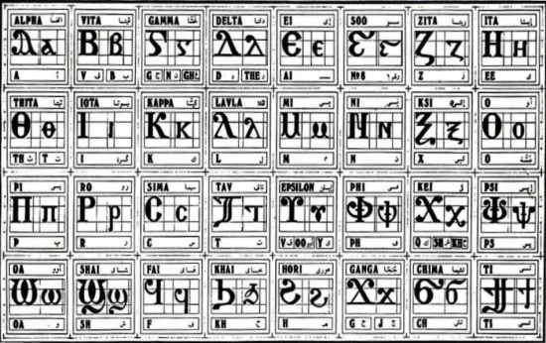
Review Questions
Coptic
Name
English
q
Khai
kh
U u
Epsilon
v, oo, ee
¢
Marteroc
Martyr
x
Exee
x
=;
"yt
9
=a=l
Allyloui`a
Rejoice
==n
tebi
50

Slide 4
Rule for the Iota i:
e
(if 1st letter in a word)
ee
I i =
(between consonants)
y
(next to a vowel)
Examples:
isi
rwmi
iom
Icrayl
niben
Ic,uroc
nai
`agioc
`<rictoc
`ilewc
Mari`a

Slide 5
Coptic Bible Verses – Part 4
}ar,y `n]covia ]ho] `nte `P[oic te The fear of the Lord is the beginning of wisdom. (Ps 110:10)
}na,w `ntahiryny nwten@ tahiryny `anok ]natyic nwten Peace I leave with you, My peace I give to you. (Jn 14:27)
Pinah] ,wric ni`hbyou`i `fmwout Faith without works is dead. (James 2:20)
`Eaukec ;ynou nemaf qen piwmc Buried with Him in baptism. (Col 2:12)

Slide 6
Vocabulary List #1
qen
in, with, by, at
ran
name
[oic
Lord
Syri
Son
`,rictoc
Christ
metouro
Kingdom
ouro
King

Slide 7
First Five Numbers
===a _ 1 (ouai)
=b = 2 (`cnau)
=g = 3 (somt)
=d = 4 (`ftoou)
=e = 5 (`tiou)

Slide 8
Numbers 6 through 10
^ _ 6 (coou)
=z = 7 (sasf)
=y = 8 (`smyn)
=; = 9 ('it)
=i = 10 (Myt)

Slide 9
Teens
==i=a _ 11 (myt-ouai)
=i=b = 12 (myt-`cnau)
=i=g = 13 (myt-somt)
=i=d = 14 (myt-`ftou)
=i=e = 15 (myt-`tiou)

Slide 10
Tens
=k = 20 (jout)
=l = 30 (map)
=m = 40 (`hme)
=n = 50 (tebi)
=x _ 60 (ce)
=o = 70 (`sbe)
=p = 80 (qamne)
=F _ 90 (pictau)

Slide 11
Hundreds
==r = 100 (se)
=c = 200 (`cnau-se)
=t = 300 (somt-se)
===, = 600 (coou-se)
=' = 700 (sasf-`nse)
=w = 800 (`smyn-se)
=s = 900 (`'it-se)
a _ 1000 (so)

Slide 12
Review the Numbers
=a =b =e =z =i =k =m =n =o =c =t =w
=e =; =l =s =p =o =c =t ==, ==' =w

Slide 13
Coptic Alphabets

Slide 14
Coptic Numbers Exercise 1
=i=a
= 11
(meet-owai)
=k=e
= 25
(Goot-etiou)
=m=z
= 47
(Ehme-shashf)
=n=b
= 52
(Tevi-esnav)
==c=o
= 270
(Esnav-she-eshve)
=t=k=b
= 322
(Shomt-she-goot-esnav)
=w=n=e
= 855
(Eshmin-she-tevi-etiou)

Slide 15
Coptic Numbers Exercise 2
=i=y
= 18
(meet-eshmein)
=k^
= 26
(Goot-soo)
=n=a
= 51
(Tevi-ouai)
=o=z
= 77
(Eshve-shashf)
==r=m
= 140
(Shae-nem-ehme)
=c=i=b
= 212
(Esnav-she-nem-meit-esnav)
=w=n=e
= 855
(Eshmin-she-tevi-etiou)

Slide 16
Coptic Numbers Exercise 3
=k=;
= 29
(jout-'it)
=l=d
= 34
(map-`ftou)
=m=z
= 47
(`hme-sasf)
=p=g
= 83
(qamne-somt)
==v=p=;
= 589
(`tiou-`nse-qamne-'it)
=c=i=b
= 212
(`cnau-se-myt-`cnau)
=w=n=e
= 855
(`smyn-`nse-tebi-`tiou)

Slide 17
Announcement
All slides are available at http://www.ekladious.com/coptic.html

Slide 18
Oujai qen `P[oic

