Slide 1
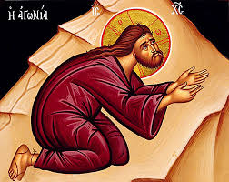
Blessed Are Those Who Have Mercy

Slide 2
Blessed Are Those Who Have Mercy
Refrain:
Blessed are those who have mercy
Who give to the poor and fast and pray
The Holy Spirit will fill their hearts
The Son will show them mercy on Judgment Day.

Slide 3
Blessed Are Those Who Have Mercy
Moses fasted for forty days To be purified in body and spirit To receive from God the two tablets With the Ten Commandments written on them.
When Moses saw the almighty God His glory filled Moses with grace The people of Israel covered their eyes They could not look at his radiant face.

Slide 4
Blessed Are Those Who Have Mercy
Fasting and prayer of the prophet Daniel Saved his life in the lions´ den The Lord kept shut the lions´ mouths For God protects His holy men.
Refrain:
Blessed are those who have mercy Who give to the poor and fast and pray The Holy Spirit will fill their hearts The Son will show them mercy on Judgment Day.

Slide 5
Blessed Are Those Who Have Mercy
Elijah fasted and prayed that the sky For three and half years would not rain That the Israelites who went astray Would feel hunger, agony and pain.
As they repented he asked the Lord To bring the rain with His mighty hand The Lord opened the gates of heaven Rain and rejoicing filled the land.

Slide 6
Blessed Are Those Who Have Mercy
Fasting and prayers of the Ninevites As they appealed to God above When they repented God forgave Their sins and filled them with His love.
Refrain:
Blessed are those who have mercy Who give to the poor and fast and pray The Holy Spirit will fill their hearts The Son will show them mercy on Judgment Day.

Slide 7
Blessed Are Those Who Have Mercy
Fasting and prayers of the Disciples Spread God’s Word to every nation Baptizing and preaching the Holy Gospel Healing and bringing salvation.
Fasting and prayers of the martyrs Gave them the power to stand the pain Knowing that even losing their lives Is nothing compared to their heavenly gain.

Slide 8
Blessed Are Those Who Have Mercy
Fasting and prayers of the righteous And cross-bearers kept them living In the caves, deserts and mountains Because of their love For Christ the King.
Refrain:
Blessed are those who have mercy Who give to the poor and fast and pray The Holy Spirit will fill their hearts The Son will show them mercy on Judgment Day.

Slide 9
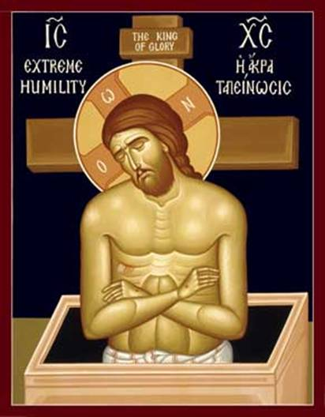
The End

