Slide 1
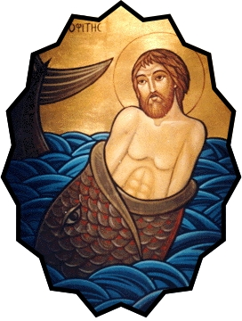
Lord, Hear My Cry
"But I will offer sacrifices to you with songs of praise." Jonah 2:9

Slide 2
Lord, Hear My Cry
Hear my cry I pray to Thee And to my voice incline Your ear Keep me and have mercy upon me (2) For You O Lord I'm in great need. (2)
My soul is troubled in the deep And my eyes are full of tears Now I remember You indeed (2) For Your salvation is near. (2)

Slide 3
Lord, Hear My Cry
All the waves came upon me I was drowned in the deep sea I asked for help where it could be (2) But in the hands of my Lord Dear. (2)
My heart is trembling in great fear And my head is wrapped in weeds Out of the depth I cried to Thee (2) Save my soul and set me free. (2)

Slide 4
Lord, Hear My Cry
God ordered the whale in the sea To safely drop Jonah in peace In the whale's belly Jonah kneeled (2) And thanked the Lord for His great deed. (2)
Hear my cry I pray to Thee And to my voice incline Your ear Keep me and have mercy upon me (2) For You O Lord I'm in great need. (2)

