Slide 1
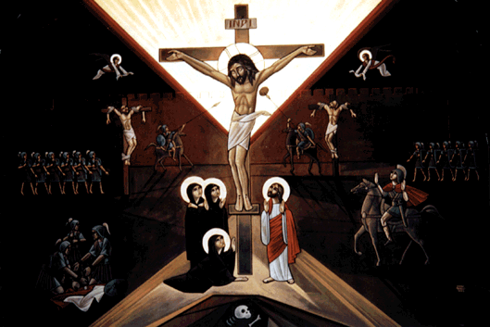
Pascha Hymns

Slide 2
¿ Pascha Doxology
:wk te ]jom nem pi`wou nem pi`cmou nem pi`amahi sa `eneh `amyn@ Emmanouyl pennou] penouro.
Thine is the power, the glory, the blessing, and the majesty, forever Amen. Emmanuel our God and our King.
:wk te ]jom nem pi`wou nem pi`cmou nem pi`amahi sa `eneh `amyn@ Pa=o=c I=y=c P=,=c@ paCwtyr `n`aga;oc@
Thine is the power, the glory, the blessing, and the majesty, forever Amen. My Lord Jesus Christ, my good Savior.
:wk te ]jom nem pi`wou nem pi`cmou nem pi```amahi sa `eneh `amyn. Thine is the power, the glory, the blessing, and the majesty, forever Amen.

Slide 3
¿ Confession of the Right-hand Thief
`Aripameu`i `wPa[oic@ aksan`i qen tekmetouro.
Remember me O Lord, when You come into Your kingdom.
`Aripameu`i `wPaouro@ aksan`i qen tekmetouro.
Remember me O Master, when You come into Your kingdom.
`Aripameu`i `wVye;ouab@ aksan`i qen tekmetouro. Remember me O Holy One, when You come into Your kingdom.

Slide 4
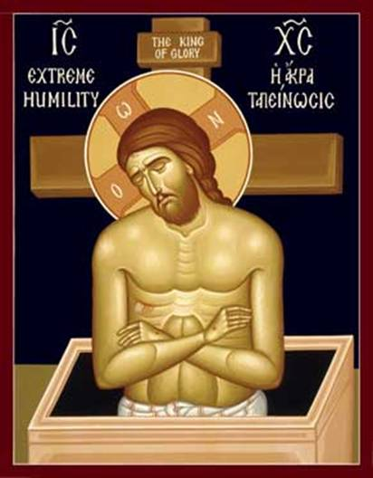
The End

