Slide 1
My Fathers the Monks

Slide 2
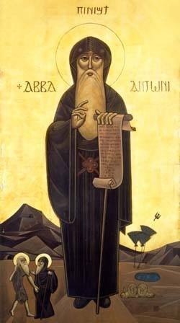
My Fathers the Monks
Refrain:
My fathers the monks of the desert
I wish to live a life like yours (2)
Life of prayer, vigils and tears (2)
You offer to our Savior
My fathers, my fathers

Slide 3
My Fathers the Monks
Father of the monks Abba Antonius
His disciple Abba Macarius (2)
Left everything of worth and value (2)
To serve our faithful Savior
My fathers, my fathers

Slide 4
My Fathers the Monks
Refrain:
My fathers the monks of the desert
I wish to live a life like yours (2)
Life of prayer, vigils and tears (2)
You offer to our Savior
My fathers, my fathers

Slide 5
My Fathers the Monks
When they were attacked by the Barbarians
No one was afraid or denied his faith (2)
They said our Lord is Jesus Christ (2)
For whom our lives we´d sacrifice
My fathers, my fathers

Slide 6
My Fathers the Monks
Refrain:
My fathers the monks of the desert
I wish to live a life like yours (2)
Life of prayer, vigils and tears (2)
You offer to our Savior
My fathers, my fathers

Slide 7
My Fathers the Monks
I am a youth struggling in the way
God's word I must learn to obey (2)
Please pray for me, Saint Anthony (2)
That Christ may abide in me fully
My fathers, My fathers

Slide 8
My Fathers the Monks
Refrain:
My fathers the monks of the desert
I wish to live a life like yours (2)
Life of prayer, vigils and tears (2)
You offer to our Savior
My fathers, my fathers

