Slide 1
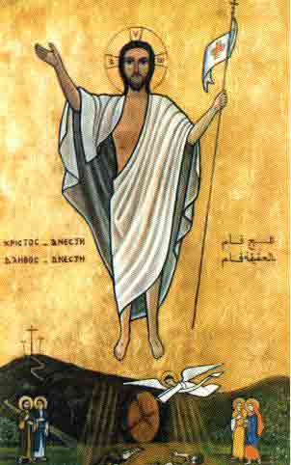
Very Early Sunday Morning

Slide 2
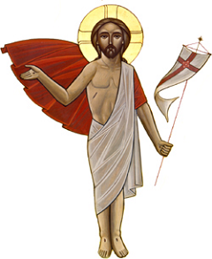
Very Early Sunday Morning
Very early Sunday morning While the guards were still asleep Jesus has risen declaring Victory no more defeat (2)
Resurrection is my song Resurrection gave me life Resurrection made me strong Jesus, my Lord is alive (2)

Slide 3
Very Early Sunday Morning
Jesus is risen in glory Heaven and earth sang and praised And the angel told the story He is risen as He said (2)
Resurrection is my song Resurrection gave me life Resurrection made me strong Jesus, my Lord is alive (2)

Slide 4
Very Early Sunday Morning
Mary Magdalene was looking In the garden for her Lord While Jesus Himself was telling Her to go and spread the word (2)
Resurrection is my song Resurrection gave me life Resurrection made me strong Jesus, my Lord is alive (2)

Slide 5
Very Early Sunday Morning
All the disciples were praying They were really in great fear When Mary came to them saying He is risen He is not here (2)
Resurrection is my song Resurrection gave me life Resurrection made me strong Jesus, my Lord is alive (2)

Slide 6
Very Early Sunday Morning
While they gathered in the room Jesus Christ Himself appeared Said My peace I gave to you And My peace with you I leave (2)
Resurrection is my song Resurrection gave me life Resurrection made me strong Jesus, my Lord is alive (2)

Slide 7
Very Early Sunday Morning
But Thomas did not believe What the disciples had seen So Jesus again appeared Showed Him the place of the spear (2)
Resurrection is my song Resurrection gave me life Resurrection made me strong Jesus, my Lord is alive (2)

Slide 8
Very Early Sunday Morning
Tell the Mary´s no more mourning Among the dead do not seek For Jesus Our Lord is living Giving power to the weak (2)
Resurrection is my song Resurrection gave me life Resurrection made me strong Jesus, my Lord is alive (2)

Slide 9
Very Early Sunday Morning
Jesus My victorious Lord Conquered the powers of Hades And the thorns of death He broke My salvation He declared (2)
Resurrection is my song Resurrection gave me life Resurrection made me strong Jesus, my Lord is alive (2)

Slide 10
Very Early Sunday Morning
The heavenly hosts were singing Welcoming our glorious Lord And the joy is overwhelming He opened the doors of hope (2)
Resurrection is my song Resurrection gave me life Resurrection made me strong Jesus, my Lord is alive (2)

Slide 11
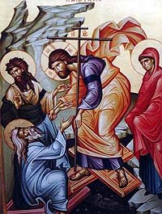
The End

